Slide 1
Chapter 2
The Simple Regression Model

Slide 2
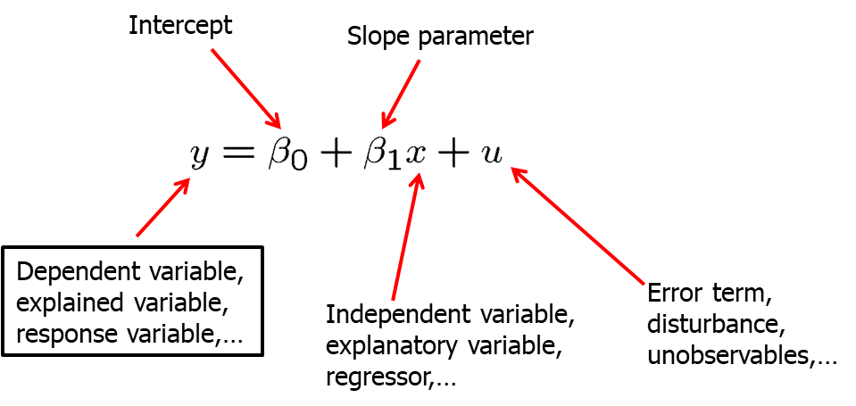
The Simple Regression Model (1 of 39)
Definition of the simple regression model
“Explains variable y in terms of variable x”

Slide 3
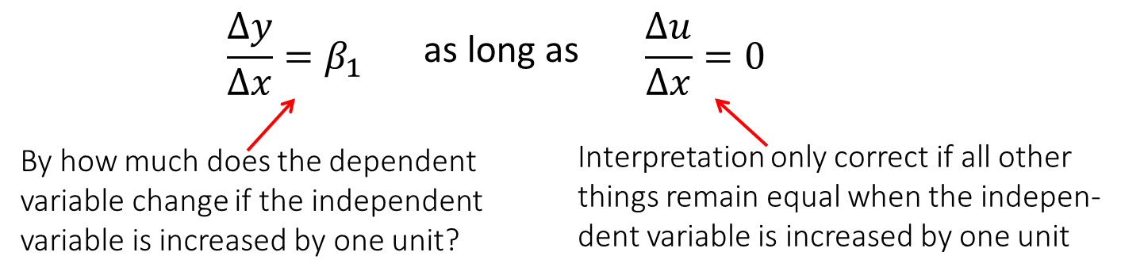
The Simple Regression Model (2 of 39)
Interpretation of the simple linear regression model
Explains how y varies with changes in x
The simple linear regression model is rarely applicable in practice but its discussion is useful for pedagogical reasons.

Slide 4
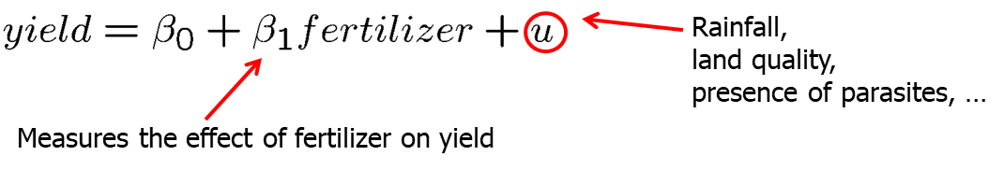
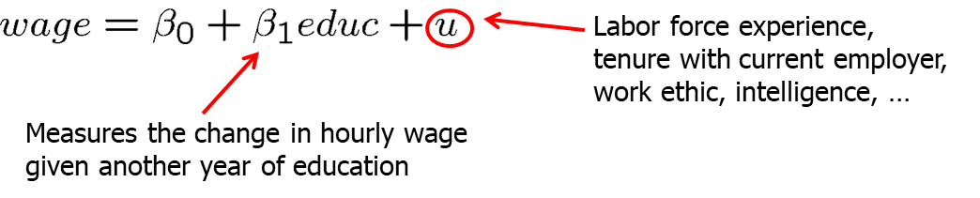
The Simple Regression Model (3 of 39)
Example: Soybean yield and fertilizer
Example: A simple wage equation

Slide 5
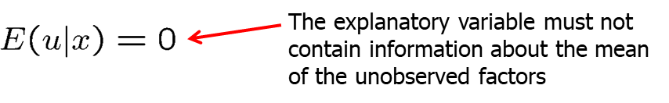
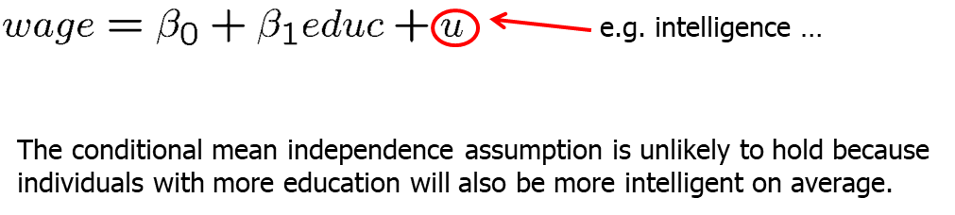
The Simple Regression Model (4 of 39)
When is there a causal interpretation?
Conditional mean independence assumption
Example: wage equation

Slide 6
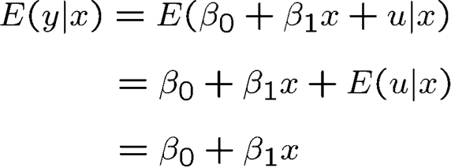
The Simple Regression Model (5 of 39)
Population regression function (PFR)
The conditional mean independence assumption implies that
This means that the average value of the dependent variable can be expressed as a linear function of the explanatory variable.

Slide 7
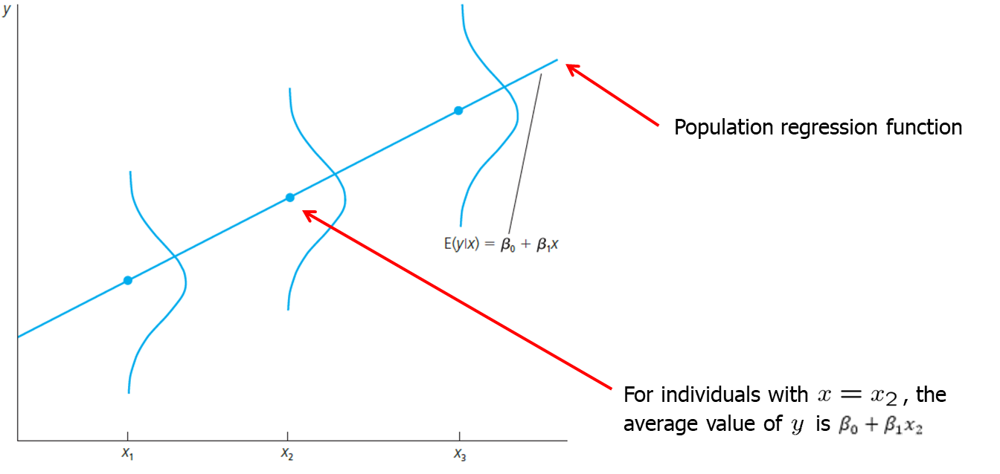
The Simple Regression Model (6 of 39)

Slide 8
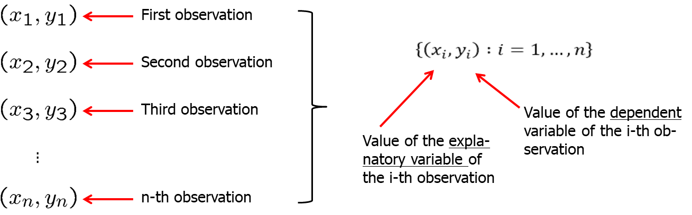
The Simple Regression Model (7 of 39)
Deriving the ordinary least squares estimates
In order to estimate the regression model one needs data
A random sample of n observations

Slide 9
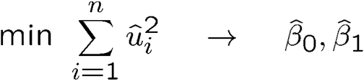
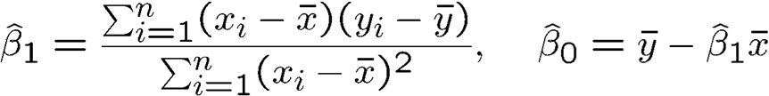
The Simple Regression Model (8 of 39)
Deriving the ordinary least squares (OLS) estimators
Defining regression residuals
Minimize the sum of the squared regression residuals
OLS estimators

Slide 10
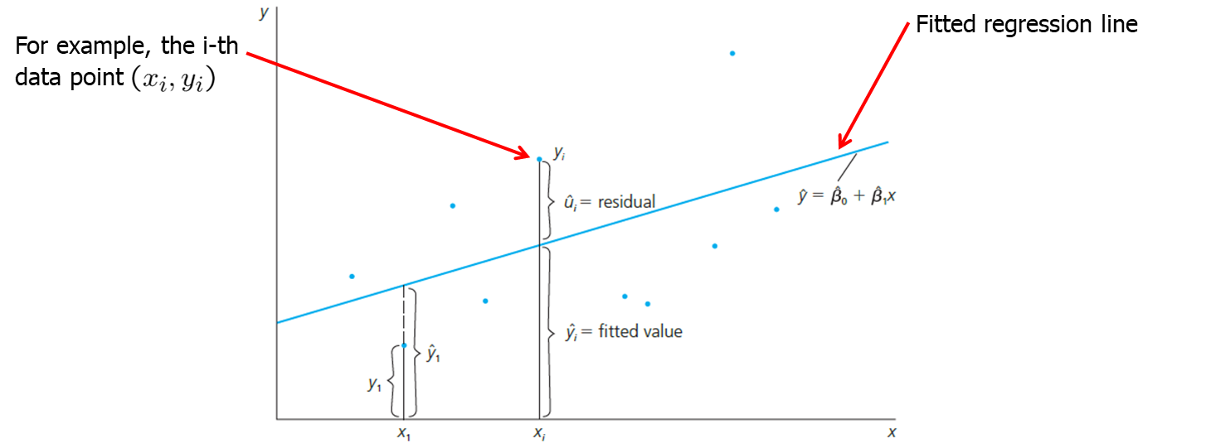
The Simple Regression Model (9 of 39)
OLS fits as good as possible a regression line through the data points

Slide 11
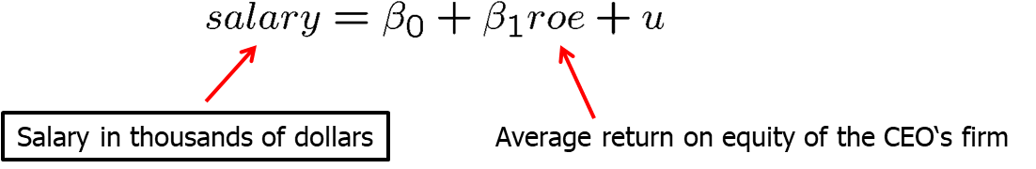
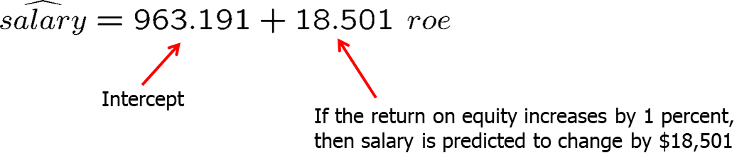
The Simple Regression Model (10 of 39)
Example of a simple regression
CEO salary and return on equity
Fitted regression
Causal interpretation?

Slide 12
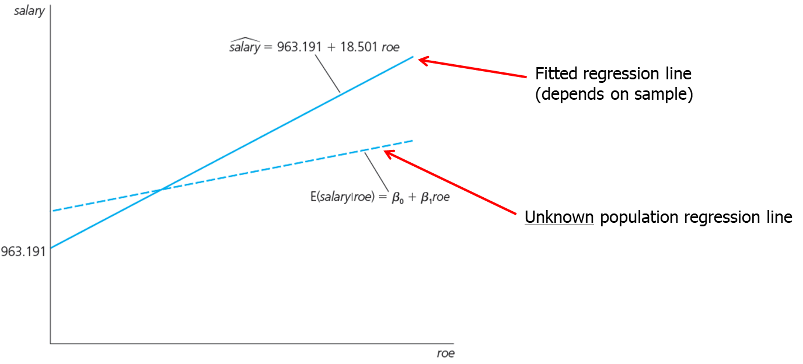
The Simple Regression Model (11 of 39)

Slide 13
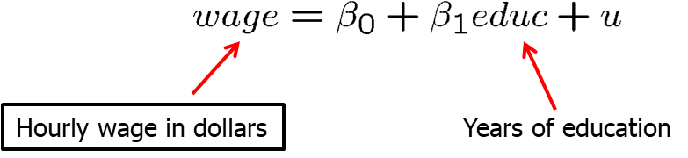
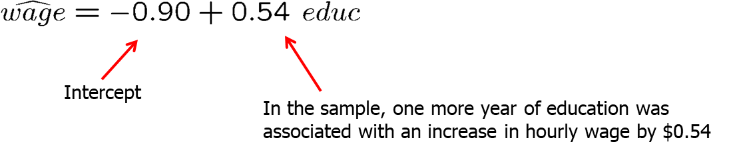
The Simple Regression Model (12 of 39)
Example of a simple regression
Wage and education
Fitted regression
Causal interpretation?

Slide 14
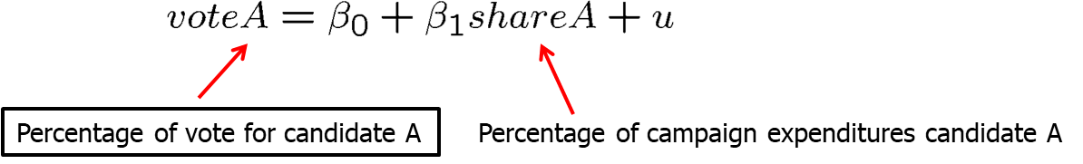
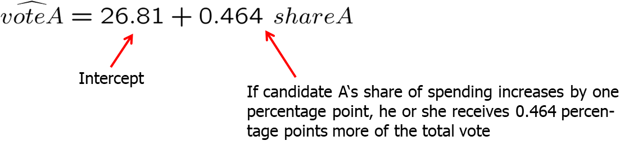
The Simple Regression Model (13 of 39)
Example of a simple regression
Voting outcomes and campaign expenditures (two parties)
Fitted regression
Causal interpretation?

Slide 15
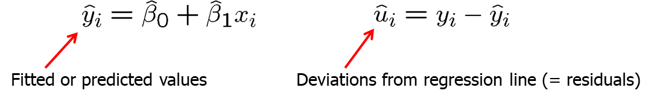
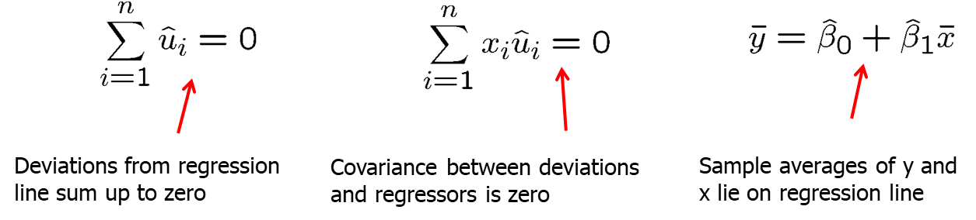
The Simple Regression Model (14 of 39)
Properties of OLS on any sample of data
Fitted values and residuals
Algebraic properties of OLS regression

Slide 16
The Simple Regression Model (15 of 39)
obsno | roe | salary | salaryhat | uhat
1 | 14.1 | 1095 | 1224.058 | -129.058
2 | 10.9 | 1001 | 1164.854 | -163.854
3 | 23.5 | 1122 | 1397.960 | -275.969
4 | 5.9 | 578 | 1072.348 | -494.348
5 | 13.8 | 1368 | 1218.508 | 149.493
6 | 20.0 | 1145 | 1333.215 | -188.215
7 | 16.4 | 1078 | 1266.611 | 188.611
8 | 16.3 | 1094 | 1264.761 | -170.761
9 | 10.5 | 1237 | 1157.454 | 79.546
10 | 26.3 | 833 | 1449.773 | -616.773
11 | 25.9 | 567 | 1442.372 | -875.372
12 | 26.8 | 933 | 1459.023 | -526.023
13 | 14.8 | 1339 | 1237.009 | 101.991
14 | 22.3 | 937 | 1375.768 | -438.768
15 | 56.3 | 2011 | 2004.808 | 6.192
This table presents fitted values and residuals for 15 CEOs.
For example, the 12th CEO’s predicted salary is $526,023 higher than their actual salary.
By contrast the 5th CEO’s predicted salary is $149,493 lower than their actual salary.

Slide 17
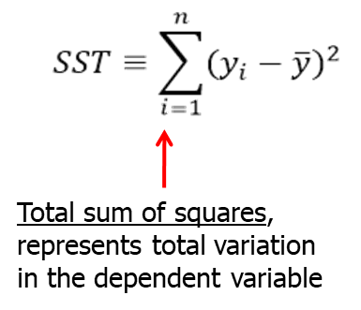
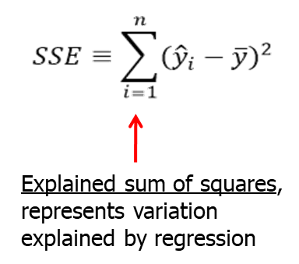
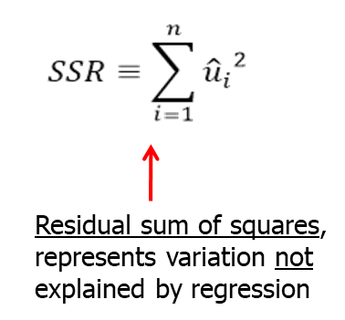
The Simple Regression Model (16 of 39)
Goodness of fit
How well does an explanatory variable explain the dependent variable?
Measures of variation:

Slide 18
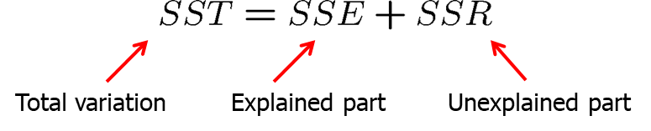
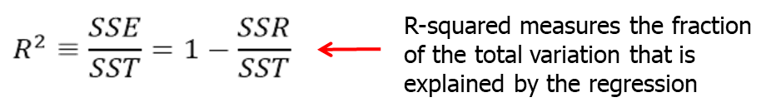
The Simple Regression Model (17 of 39)
Decomposition of total variation
Goodness-of-fit measure (R-squared)

Slide 19
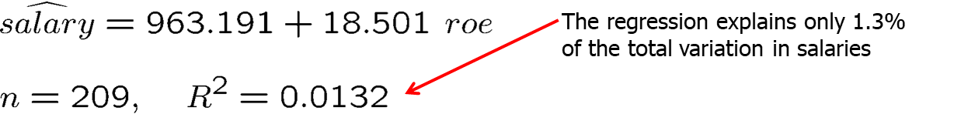
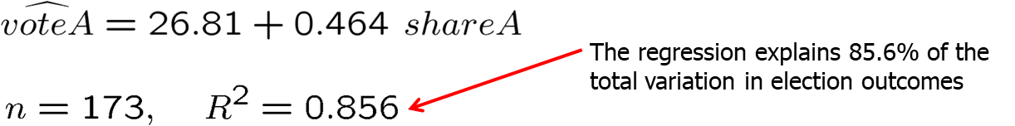
The Simple Regression Model (18 of 39)
CEO Salary and return on equity
Voting outcomes and campaign expenditures
Caution: A high R-squared does not necessarily mean that the regression has a causal interpretation!

Slide 20
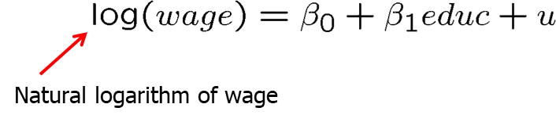
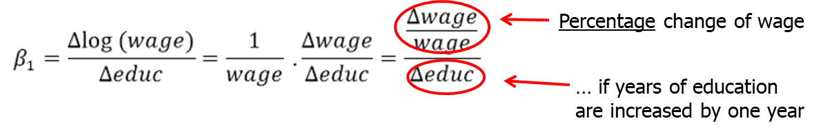
The Simple Regression Model (19 of 39)
Incorporating nonlinearities: Semi-logarithmic form
Regression of log wages on years of education
This changes the interpretation of the regression coefficient:

Slide 21
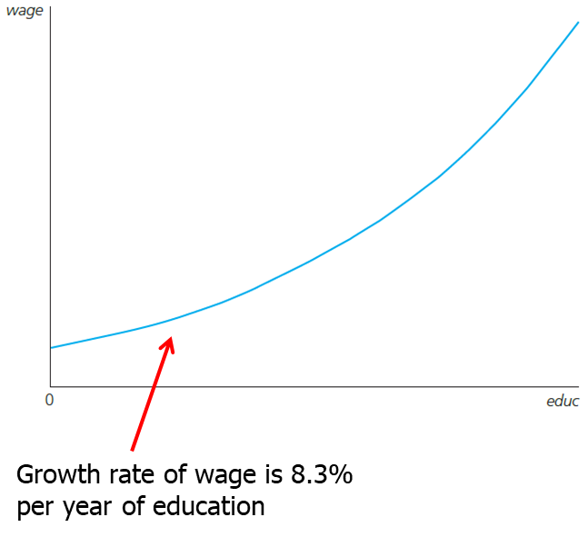
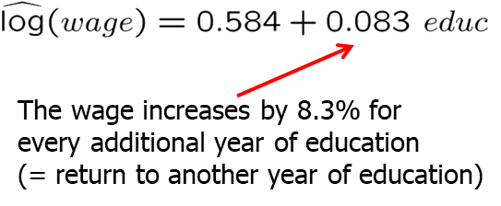
The Simple Regression Model (20 of 39)
Fitted regression

Slide 22
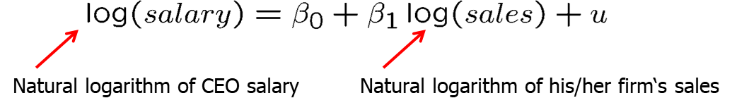
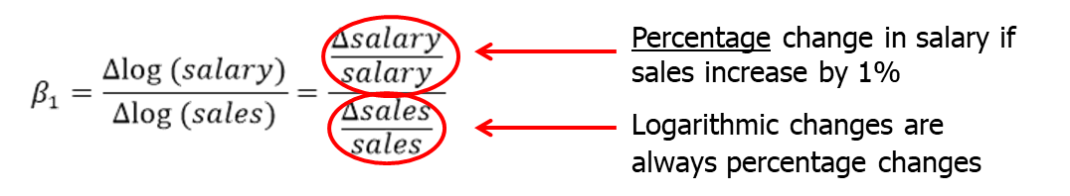
The Simple Regression Model (21 of 39)
Incorporating nonlinearities: Log-logarithmic form
CEO salary and firm sales
This changes the interpretation of the regression coefficient:

Slide 23
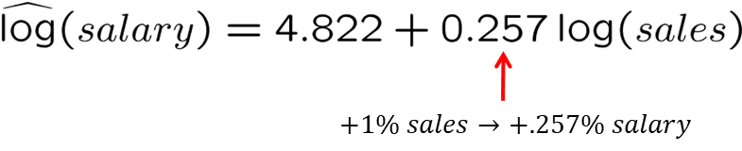
The Simple Regression Model (22 of 39)
CEO salary and firm sales: fitted regression
The log-log form postulates a constant elasticity model, whereas the semi-log form assumes a semi-elasticity model.

Slide 24
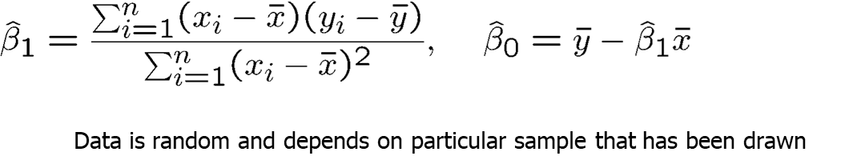
The Simple Regression Model (23 of 39)
Expected values and variances of the OLS estimators
The estimated regression coefficients are random variables because they are calculated from a random sample
The question is what the estimators will estimate on average and how large will their variability be in repeated samples

Slide 25

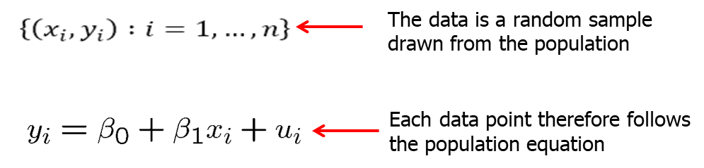
The Simple Regression Model (24 of 39)
Standard assumptions for the linear regression model
Assumption SLR.1 (Linear in parameters)
Assumption SLR.2 (Random sampling)

Slide 26
The Simple Regression Model (25 of 39)
Discussion of random sampling: Wage and education
The population consists, for example, of all workers of country A
In the population, there is a linear relationship between wages (or log wages) and years of education.
Draw completely randomly a worker from the population
The wage and the years of education of the worker drawn are random because one does not know beforehand which worker is drawn.
Throw that worker back into the population and repeat the random draw n times.
The wages and years of education of the sampled workers are used to estimate the linear relationship between wages and education.

Slide 27
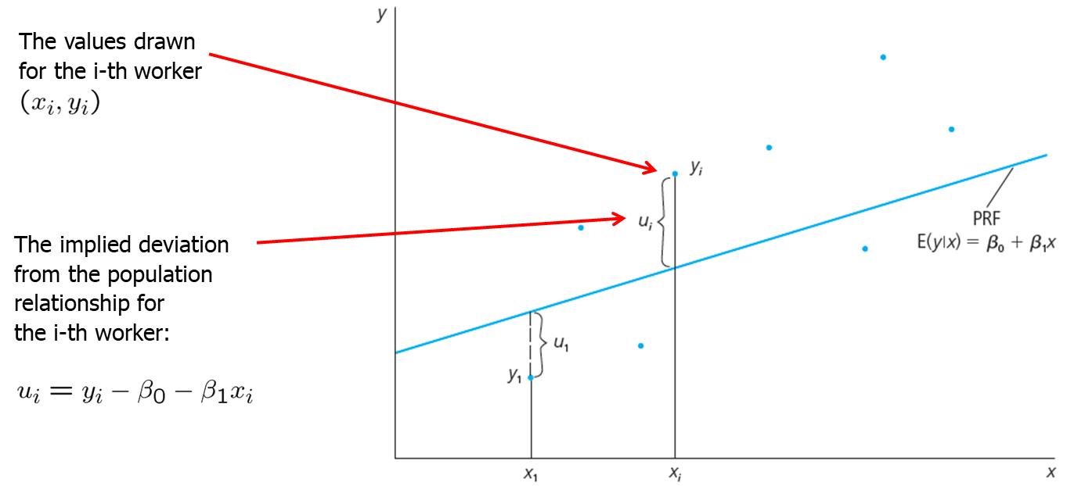
The Simple Regression Model (26 of 39)

Slide 28
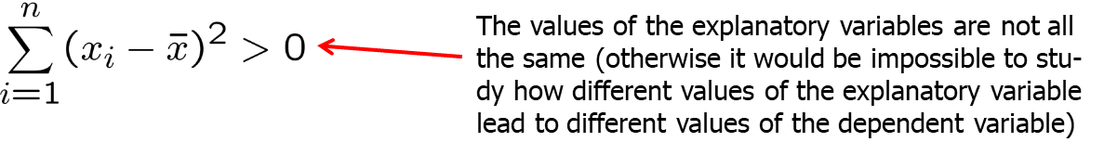
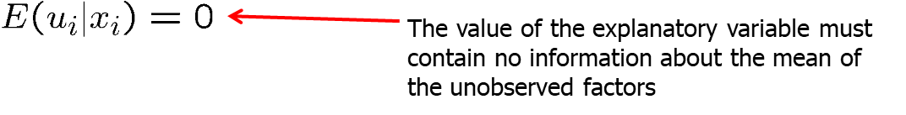
The Simple Regression Model (27 of 39)
Assumptions for the linear regression model (cont.)
Assumption SLR.3 (Sample variation in the explanatory variable)
Assumption SLR.4 (Zero conditional mean)

Slide 29
The Simple Regression Model (28 of 39)
Theorem 2.1 (Unbiasedness of OLS)
Interpretation of unbiasedness
The estimated coefficients may be smaller or larger, depending on the sample that is the result of a random draw.
However, on average, they will be equal to the values that characterize the true relationship between y and x in the population.
“On average” means if sampling was repeated, i.e. if drawing the random sample and doing the estimation was repeated many times.
In a given sample, estimates may differ considerably from true values.

Slide 30

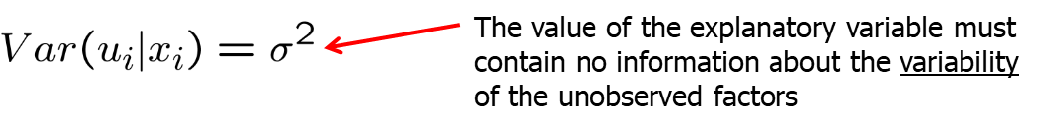
The Simple Regression Model (29 of 39)
Variances of the OLS estimators
Depending on the sample, the estimates will be nearer or farther away from the true population values.
How far can we expect our estimates to be away from the true population values on average (= sampling variability)?
Sampling variability is measured by the estimator‘s variances
Assumption SLR.5 (Homoskedasticity)

Slide 31
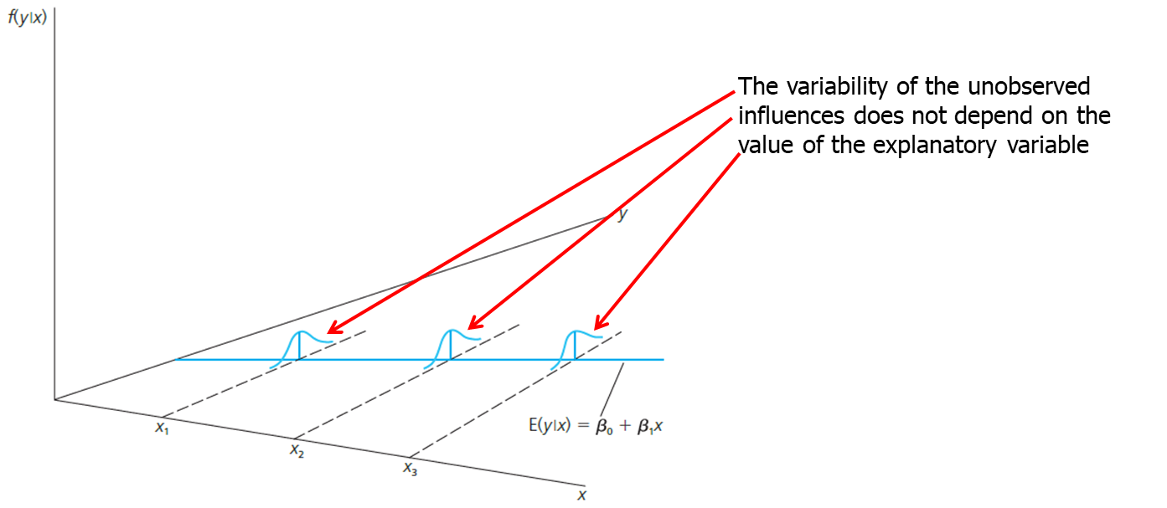
The Simple Regression Model (30 of 39)
Graphical illustration of homoskedasticity

Slide 32
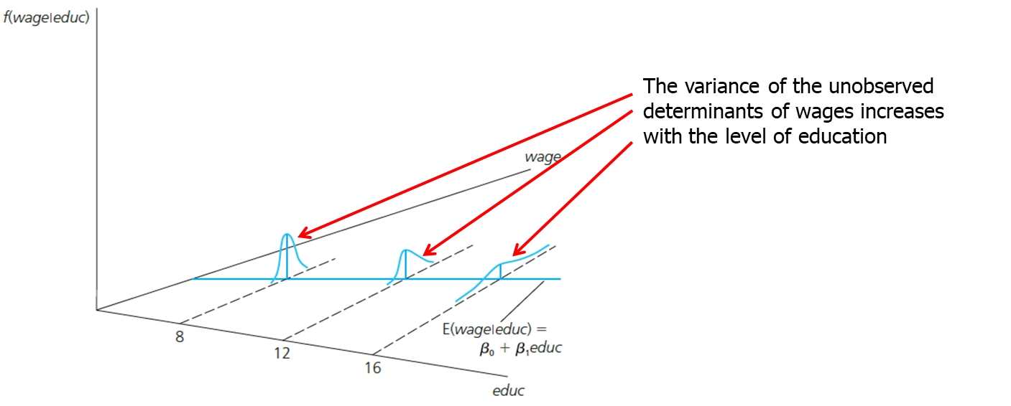
The Simple Regression Model (31 of 39)
An example for heteroskedasticity: Wage and education

Slide 33
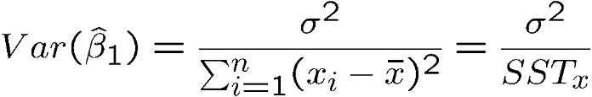
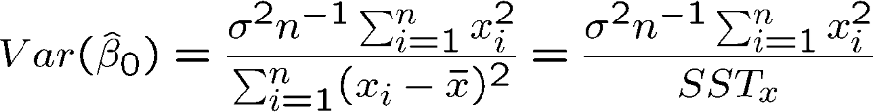
The Simple Regression Model (32 of 39)
Theorem 2.2 (Variances of the OLS estimators)
Under assumptions SLR.1 – SLR.5:
Conclusion:
The sampling variability of the estimated regression coefficients will be the higher, the larger the variability of the unobserved factors, and the lower, the higher the variation in the explanatory variable.

Slide 34
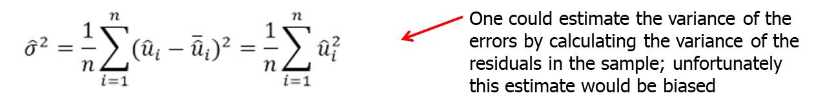
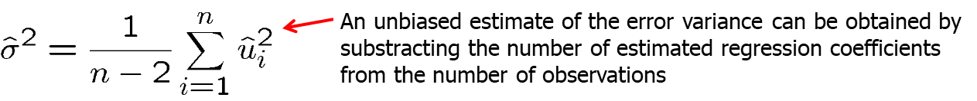
The Simple Regression Model (33 of 39)
Estimating the error variance

Slide 35
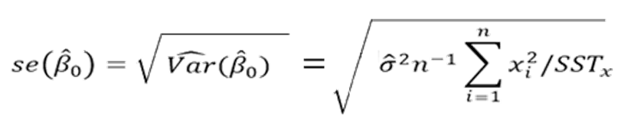
The Simple Regression Model (34 of 39)
Theorem 2.3 (Unbiasedness of the error variance)
Calculation of standard errors for regression coefficients
The estimated standard deviations of the regression coefficients are called “standard errors.” They measure how precisely the regression coefficients are estimated.

Slide 36
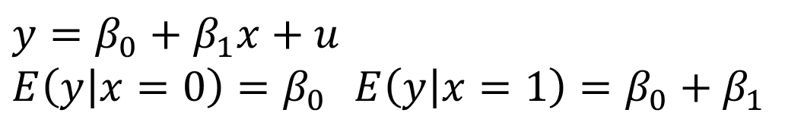

The Simple Regression Model (35 of 39)
Regression on a binary explanatory variable
Suppose that x is either equal to 0 or 1
This regression allows the mean value of y to differ depending on the state of x
Note that the statistical properties of OLS are no different when x is binary

Slide 37


The Simple Regression Model (36 of 39)
Counterfactual outcomes, causality and policy analysis
In policy analysis, define a treatment effect as:
Note that we will never actually observe this since we either observe y_{i}(1) or y_{i}(0) for a given i, but never both.
Let the average treatment effect be defined as:

Slide 38

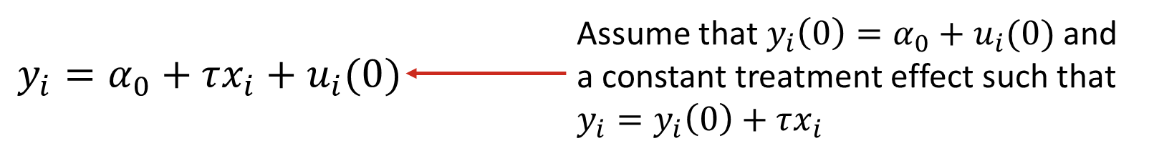
The Simple Regression Model (37 of 39)
Counterfactual outcomes, causality and policy analysis (contd.)
Let x_{i} be a binary policy variable.
This can be written as:
Therefore, regressing y on x will give us an estimate of the (constant) treatment effect.
As long as we have random assignment, OLS will yield an unbiased estimator for the treatment effect τ.

Slide 39
The Simple Regression Model (38 of 39)
Random assignment
Subjects are randomly assigned into treatment and control groups such that there are no systematic differences between the two groups other than the treatment.
In practice, randomized control trials (RCTs) are expensive to implement and may raise ethical issues.
Though RCTs are often not feasible in economics, it is useful to think about the kind of experiment you would run if random assignment was a possibility. This helps in identifying the potential impediments to random assignment (that we could conceivable control for in a multivariate regression).

Slide 40

The Simple Regression Model (39 of 39)
Example: The effects of a job training program on earnings
Real earnings are regressed on a binary variable indicating participation in a job training program.
Those who participated in the training program have earnings $1,790 higher than those who did not participate.
This represents a 39.3% increase over the $4,550 average earnings from those who did not participate.

